Slide 1

Data Analyst
Vs
Data Scientist

Slide 2

Data Analyst and Data Scientist are the two similar terms which often confuse one.

Slide 3
But before understanding the difference we must get clearity about the commonly used term
Data Analytics

Slide 4
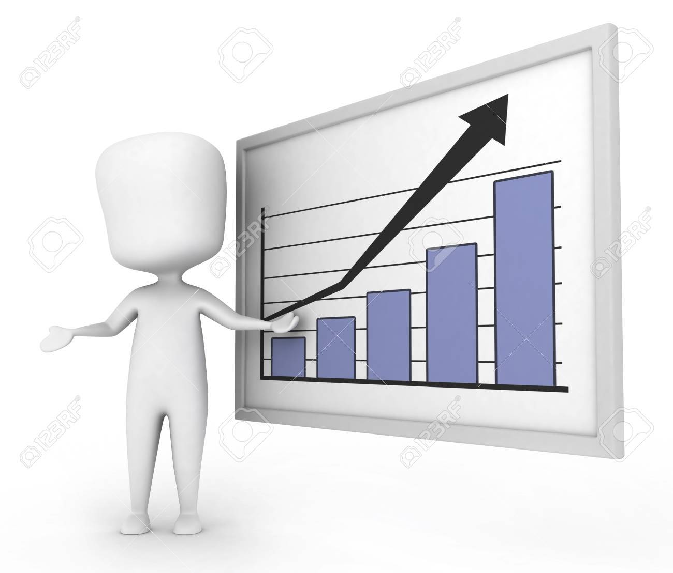

Data Analytics is coined with two terms DATA + ANALYTICS
DATA
ANALYTICS
Data is some meaningful information build around certain observations.
It refers to study based on historical data to potentially analyse trends or the performance of tools or the effort of certain decision.

Slide 5

Who are Data Analyst?
Who are Data Scientist?

Slide 6


Who are Data Analysts ?
A Data Analyst collects data.
They analyse all the numeric and other kind of data and translate it into understandable language.
Then they analyse it to predict or examine the trends or the effect of certain decision.

Slide 7
Skills
Education
Programming Languages (R/SAS)
Creative and Analytical Thinking
Strong and Effective Communication
Data Visualization
Data Warehousing
SQL Databases
Database Querying Languages
Data Mining, Cleaning and Munging
There are some positions which may only require a high school diploma, data analyst education prequisite usually consist of at least a bachelor’s degree.

Slide 8
Who are Data Scientist ?
A Data Scientist’s mission is similar to that of a Data Analyst’s find actionable insights that are key to a company’s growth and decision-making. However, a Data Scientist role is needed when a company’s data volume and velocity exceeds a certain level that requires more robust skills for sorting through a rolling sea of unstructured data (big data) to identify questions and pull out critical information. The person then cleanses the data for proper analysis and creates new algorithms to run queries that relate data from disparate sources.

Slide 9
Skills
Education
Statistics
At least one programming language – R/ Python
Data Extraction, Transformation, and Loading
Data Wrangling and Data Exploration
Machine Learning Algorithms
Advanced Machine Learning (Deep Learning)
Big Data Processing Frameworks
Data Visualization
Bachelor's degree in IT, computer science, math, physics, or another related field
Master's degree in data or related field

Slide 10

The key difference between the two is how the data is being used by them.

Slide 11
Difference :-
1.A data scientist is the one who examine the trends based on previous patterns whereas a data analysts is the one who predict some meaningful vision from data.
2.A data analyst direct business complications but a data scientist also picks up those issues that will have the most business value once solved.
3.A data scientist job roles involves estimating the unknown whilst a data analyst job roles involves looking at the known from new perspectives.

Slide 12
THANK YOU
Hope you understand the topic.

